Slide 1
Junior League of Eau Claire
Spring Business Meeting

Slide 2
Agenda
Call to Order
Treasurer’s Report
Diaper Bank Report
Proposals
WEAU/United Way Diaper Drive Partnership
Children’s Museum
Google WorkSpace Subscription
Summer Plans
Open Discussion
Adjournment

Slide 3
Treasurer’s Report
Leah Calvin, Treasurer
FY 20/21 Review
FY 21/22 Budget Proposal
Vote
Notes:
Junior League is in 4 countries: United States, Mexico, Canada, United Kingdom.
Over 125,000 women in 290 communities

Slide 4
Diaper Bank, CY2020 in Review
Diapers donated: 156,913
1 bulk diaper purchase, April 2020
Training pants donated: 92,959
Women’s Incontinence Pads donated: 90,720
Monetary Donations: $7,560
$4348 in FY 20/21
Notes:
NDBD uses calendar years for reporting, not fiscal years

Slide 5
Diaper Bank, CY2021 To Date Review
Diapers Donated: 31,169
1 bulk diaper purchase February 2021
Training Pants Donated: 78
Disposable Briefs Donated: 160

Slide 6
Diaper Bank - Proposal
The United Way reached out regarding interest from WEAU to do a city-wide diaper drive
WEAU would take the lead
United Way would lend their name
JLEC would need to provide the space at FMP
Potential to have booths at Farmer’s Market
Request that JL staff that booth ~2-3 weekends
Vote

Slide 7
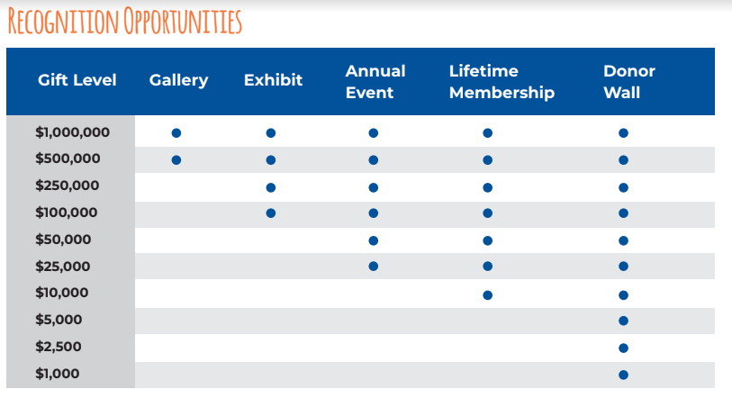
Children’s Museum - Proposal
New Children’s Museum being built soon
Agreement to have a permanent diaper drop location
How should we support?
Woman power? This will be a need, specifically for moving
Financial? We can stipulate where funds are used
Both?
Proposal and vote?

Slide 8
Google WorkSpace - Proposal
Google WorkSpace
Storage
Current storage is a bit clumsy with access
Unlimited access to GoogleMeet for virtual meetings
Virtual meetings are unlikely to go away
Calendar (could link to website)
Potential to update without web designer intervention
Free for qualifying non-profits
Vote

Slide 9
Summer Plans - GMMs
May - end of year get together?
Poll for in person meeting
June - Brainstorm for League Fundraiser(s) 21/22
July - Independence Day party?
Propose moving to a later date. Perhaps July 9, 10, 16, or 17
August - Back to School
Partner with ECASD for school supply drive?
Partner with LCV for Literacy Month?
September
Propose moving to a later date due to school starting. Perhaps Sept 9

Slide 10
Q & A
and
Open Discussion
Notes:
First Thursday monthly meetings - repoll?
Reminder: Dues for 21/22 are $110

